Slide 1
Hashtag Sentiment Disambiguation using KG
Kartik Joshi

Slide 2
Hashtags and Sentiments
Twitter Hashtags define the inherent sentiment in a nation.
Versatility of Hashtag has made it difficult to disambiguate the sentiment
Example : #9Baje9Minute was initiated by PM Narendra Modi on April 5th for the mass campaign of lighting diyas at 9PM for 9 minute for showing the sentiment of solidarity.
More recently, September 2nd – September 9th , #9Baje9Minute became trending again but for a different reason this time. This time it was outrage related to privatization of government organizations and conducting RRB exams amidst pandemic.

Slide 3
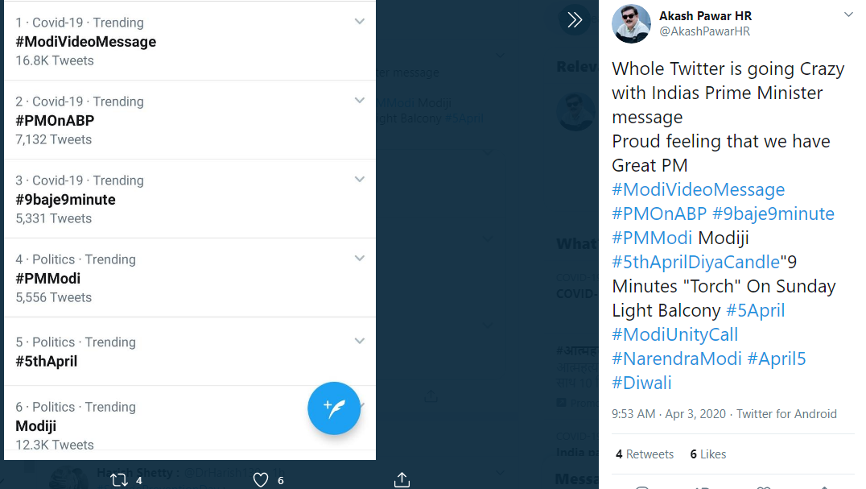
April 5, 2020

Slide 4
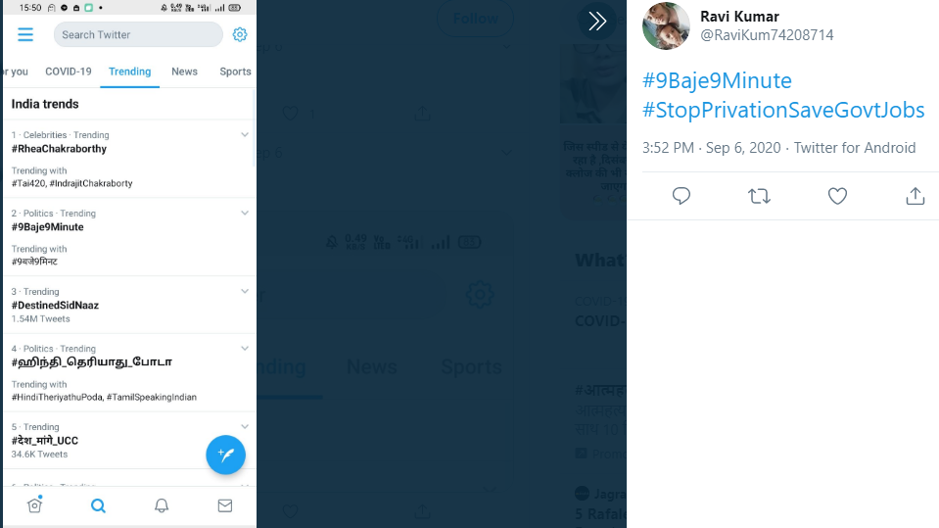
September 6, 2020

Slide 5
So, it is important to study the lifecycle of a # for difference in sentiments.

Slide 6
Knowledge Graphs
This is where Knowledge Graphs come to picture.
It is a kind of database that uses nodes and edges to represent the different entities.
Basically, it makes data volatile and lets us weave a story around it for getting meaningful inferences.
Time Series Analysis on Knowledge Graphs can help in getting a gist of the context of Hashtag.
KG + Sentiment Analysis on tweets can collectively help for the task of Hashtag Disambiguation
Word Cloud results can further compliment and validate the results of the above approach.

Slide 7
Knowledge Graph for September 7-8 tweet.
Graph shown in the next slide is the KG for Sept 7-8 tweets (2k tweets)
Blue Circle highlighted is the twitter handle of Piyush Goyal, Rail Minister of India. He was mentioned frequently during the period due to RRB exams.
It is clear that the context of hashtag changed over the course of few months.

Slide 8
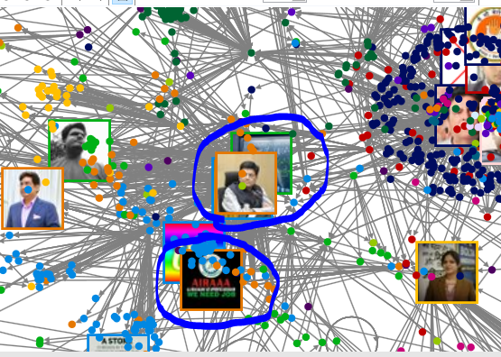

Slide 9
Future Work
Knowledge Graph was developed using NodeXL tool.
The Pro version of the feature also has the Time Series Analysis which can help in hashtag disambiguation
Sentiment Analysis of the NodeXL might not be reliable due to multilingual tweets and word level parsing.
Other models could also be further explored.

